Slide 1
PROJECT MUSE:
MIDDLE-UPPER SPECIAL EDUCATION
325T Preservice Improvement Grant
A Bank Street College and Bridges for Learning Collaborative

Slide 2
325T: Special Education Preservice Improvement Grant
Develop a highly-effective model for 7-12 special education teacher preparation
Align special education instructional strategies with general curriculum course content
Intensify field experiences to prepare teachers for challenging multicultural settings
Contact: Bonnie D. Jones, Ed.D.
Office of Special Education Programs
US Department of Education

Slide 3
MUSE Design Team Collaborators
Andrea Spencer
Shana Zaslow
Karina Otoya-Knapp
Jessica Millstone
Curriculum Team Members
Sanda Balaban
Tammy Vu
Design Team Members
Advisory Board

Slide 4
ADVISORY PERSPECTIVES
College faculty
LEA Administrators
Special Education
Literacy
Career & Technical Education
Multiple Pathways
Teacher Development
Community-based Organizations
Working Teachers
Bank Street graduate students
Independent schools

Slide 5
MAKINGS OF MUSE
Close collaboration with public schools;
Strong foundations grounded in research and evidence-based practices;
Culturally-responsive teaching; and,
On-going evaluation and quality improvement.

Slide 6
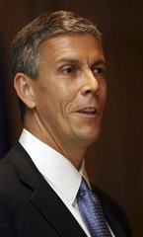
NATIONAL
POLICY PUSH
Revolutionary change not evolutionary tinkering
New teachers must master content
Well-supported, embedded fieldwork experiences
Teaching excellence through the lens of student achievement
Notes:
Arne Duncan in a speech at Teachers College last fall -

Slide 7
THE DESIGN CHALLENGE
An innovative special education 7-12 program, including course content & clinical experiences integrating theory and practice;
A dynamic approach consistent with NYSED requirements and professional standards;
Powerful clinical teaching experiences in urban schools through Collaborative Team Teaching (CTT) and other service delivery models.
Notes:
Underlying Rationale
Arne Duncan has offered criticisms of current teacher education programs, calling most of them mediocre and calling for dramatic change. This call has been echoed by Merryl Tisch, Chancellor of the Board of Regents.
A particular area of need is secondary special education where graduation rates are 4% according to the New York City Department of Education.
A related need at the secondary level is for highly qualified special education teachers with strong preparation in content areas. For that reason, this program will focus on recruitment and training of teachers who already have acquired at least one content area certification.
Mandates for inclusion and increasing popularity of Collaborative Team Teaching (CTT) models, suggests that teacher preparation must include a strong emphasis on integrating special and general education perspectives and strategies as well as the ability to work with parents from diverse backgrounds and with related service personnel

Slide 8
SUCCESS MEANS -
Fully prepared special education middle and high school teachers in shortage areas; and,
Access and achievement for students with disabilities from diverse cultural, ethnic, linguistic and socio-economic backgrounds.

Slide 9
DESIGN ELEMENTS
Multi-media on-line case studies as focal points (Design Team)
Case development linked to field experiences (graduate students)
Integrative seminars bridged by collaborative on-line study (Curriculum Team)
Notes:
Refer to case format

Slide 10
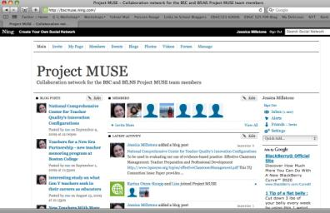
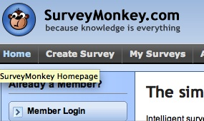
A 21ST CENTURY APPROACH
Online collaborative planning through Google Docs
Moderated Social Networking and Blog Development through Ning.com
Bank Street LMS
Surveys and Evaluation

Slide 11
Year I: BUILDING BLOCKS
Assessing needs through the eyes of practitioners and policy-makers
Articulating and aligning program goals with SED requirements
Building multimedia, on-line case studies
Defining and integrating curriculum elements
Preparation for internal and external program approval
Notes:
Handout – questionnaire – bar graphs
Handout – goals
Design Team

Slide 12
DESIGN TEAM INSIGHTS

Slide 13
THE DESIGN TEAM
Who: Public school teachers and administrators (14)
What: Flip cameras and learning artifacts as components of multimedia, web-based cases
When: Academic year
Where: Public middle and high school classrooms
Why: Strong research support for case study approaches linking theory and practice

Slide 14
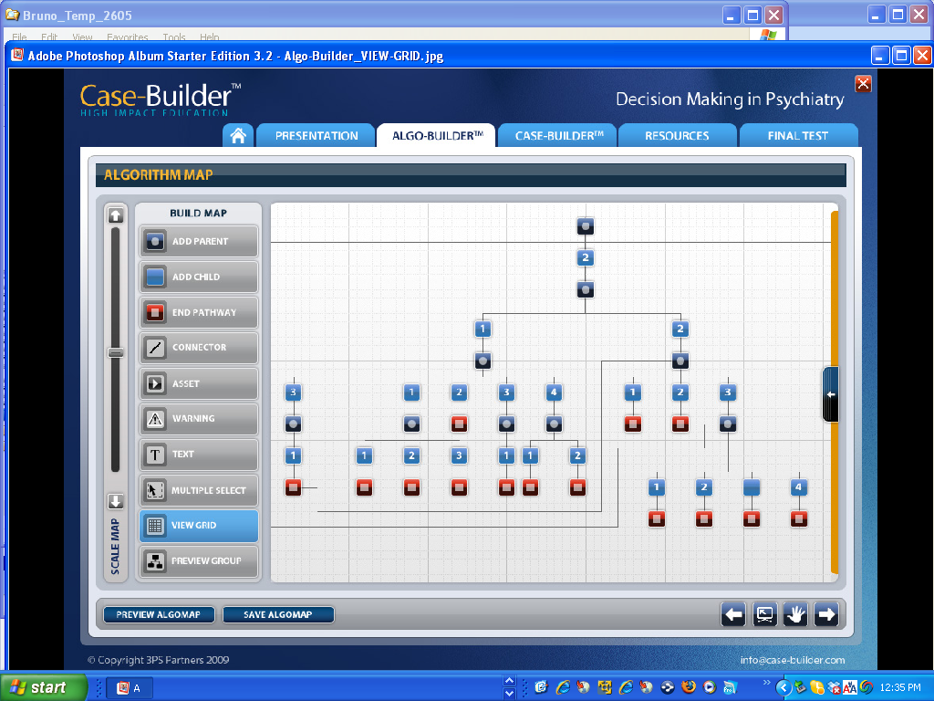
Introducing Casebuilder
Notes:
Web-enabled
Real kids
Multiple perspectives
Multiple assets
Options for branching and eventual simulation versions

Slide 15
The Curriculum Team
Who: Team of (5) general and special education faculty
What: Reviewed existing syllabi, state and professional (CEC) standards, generated program goals, created framework for delivery
When: Academic year (spring semester)
Why: Consistency with progressive Bank Street philosophy and realities of time and personnel resources
Notes:
Established Google Docs and Ning websites as tools for communication and to experiment with formats for hybrid course presentation
Note: Evaluation component based on California PACT is in process with the Project Co-Directors

Slide 16
SHARING PERSPECTIVES

Slide 17
Year 2: Looking ahead
Continued development and refinement of sequential case studies complementing the course of study
Pilot testing case studies with master teachers and novices (graduate students)
Development and coordination of course sequence and on-line components
Funding initiatives for tuition, outreach and recruitment

Slide 18
YEARS 3-5: REFINING THE MODEL
Definition and implementation of program pilot (24 graduate students with content-area certification)
Evaluation of all program components related to teacher performance and student outcomes
Continued adjustment and case development
Collaborative induction support with school districts
Establish ongoing feedback group with program graduates

Slide 19
PROJECT MUSE: A WORK IN PROGRESS
A Bank Street College and Bridges to Learning Collaborative
Andrea (Penny) Spencer
Shana Zaslow

